Slide 1
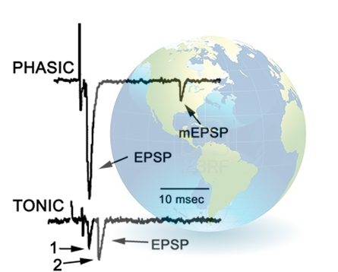

Citizen science with high school students and adults from around the world participating in analysis of synaptic transmission
R.L. Cooper, Z.R.Majeed, C. Malloy, D. Potts, K. Zeidler-Watters, R.M. Krall, D. Johnson, S. Mayo, G. Zwanzig, H. Anderson, W. Colgan III, W.-Y. Chung, A. Megighian, and E.E. Dupont-Versteegden

Slide 2
Quantifying synaptic transmission in various experimental paradigms
We turn to a citizen science approach
http://web.as.uky.edu/Biology/faculty/cooper/Citizen%20Science%20folder/CitizenScienceProjectPage.htm
Teams:
High Schools in Lexington and Louisville, KY., USA
University of Kentucky, Lexington, KY, USA
Wright State University, Dayton, OH, USA
Seoul National University, South Korea
Korean Military Academy, South Korea
Univesity of Salahaddin, Erbil, Iraq
Universität Leipzig, Germany
University of Padova, Italy
Kazan, Russia
Notes:
Ky is at the tip of the quantal trace

Slide 3
Goal of this project
The goal here is to have the public and interested parties participate in data analysis of synaptic transmission which will help answer related authentic research questions.
A hope is also that novel methodological approaches will be forthcoming and interpretations of the results can be shared for various researchers to benefit.

Slide 4
Short course
Online texts and YouTube clips to understand the basics of synaptic transmission.
Educational experience as well as discovery based learning.

Slide 5
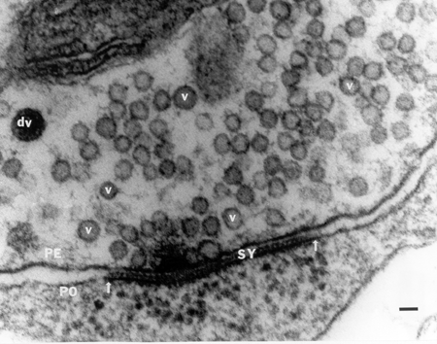

Slide 6
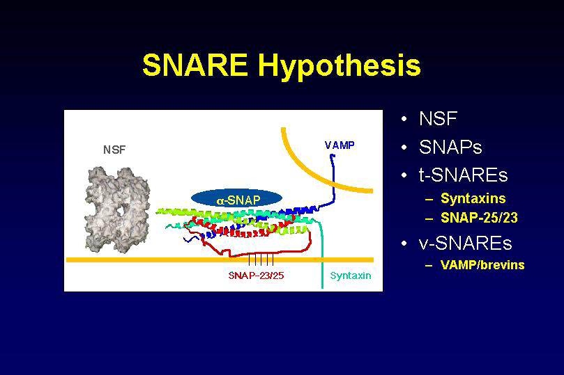
The Nobel Prize in Physiology or Medicine 2013 was awarded jointly to James E. Rothman, Randy W. Schekman and Thomas C. Südhof "for their discoveries of machinery regulating vesicle traffic, a major transport system in our cells".

Slide 7
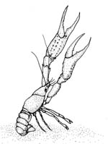
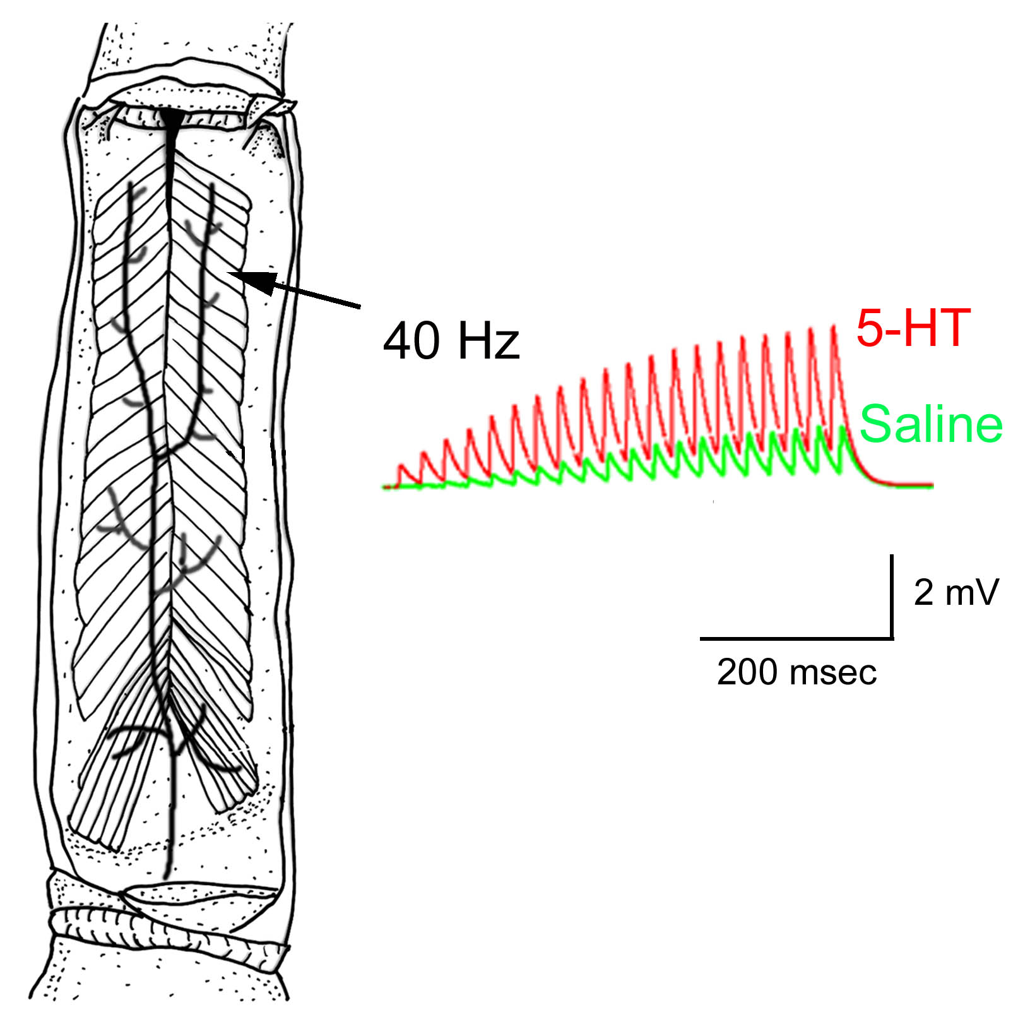
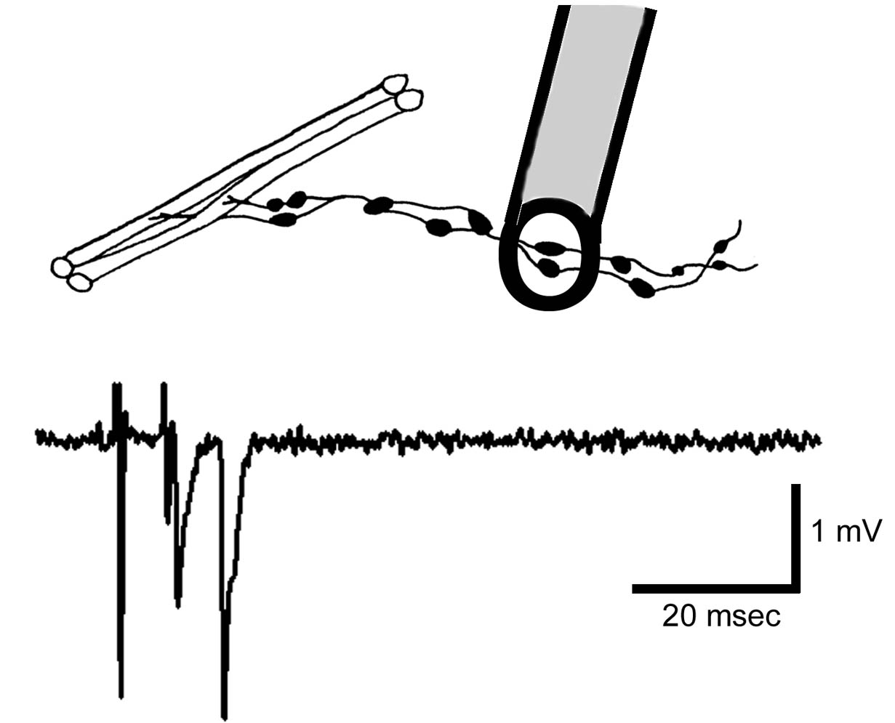

Slide 8
Axons
Varicosities

Slide 9
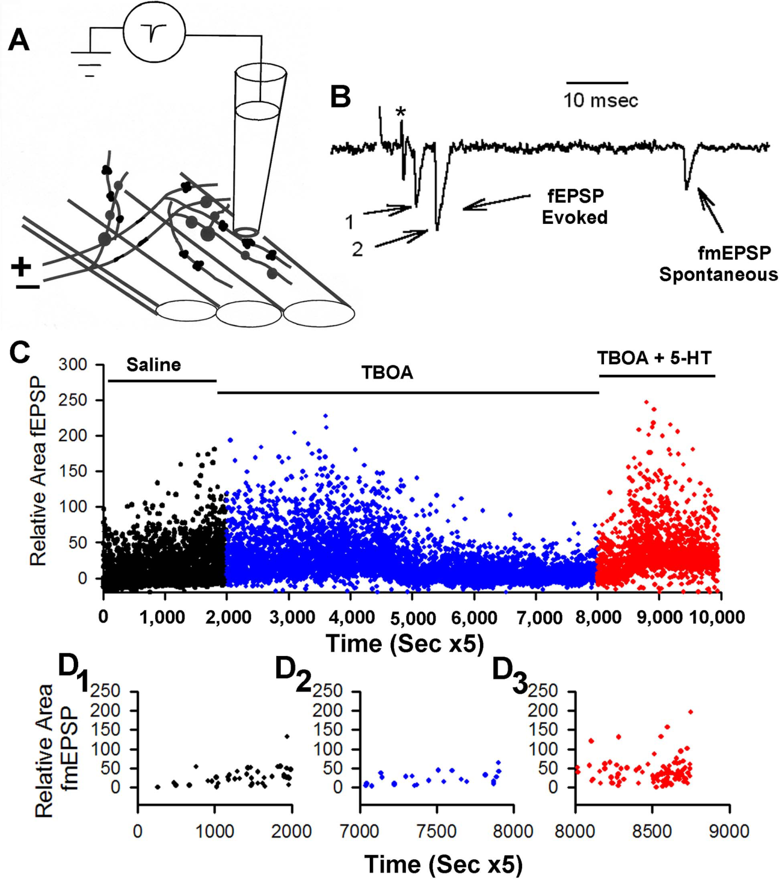

Slide 10
Drug X
Wash out of Drug X

Slide 11
In the case of the low output nerve terminal, a direct counting method of estimating mean quantal content is possible. The following equation is commonly utilized:
∑ (# of failures)(0) + (# of singles)(1)+ (# of doubles)(2)…
Mean quantal content =
Total number of stimulus trials
Two other approaches are to obtain the average peak amplitude of the evoked events and divided by the average of the spontaneous (single quantal) events.
Mean amplitude (or area) of evoked quantal events
Mean quantal content =
Mean amplitude (or area) of spontaneous quantal events
All three methods presented have drawbacks and one method may prove to be a better measure than another depending of the quality of the recordings and nature of the synaptic transmission.

Slide 12
Detailed analysis for direct counting, peak amplitude and area measures are shown in an educational video in three series which was initially produced to teach students in a neurophysiology lab.
The first YouTube movie explains the preparations (http://www.youtube.com/watch?v=zvvvoCccII0&feature=youtu.be )
and the second YouTube movie the dissection procedures, (http://www.youtube.com/watch?v=wveHR8jKTac&feature=youtu.be )
while the third one shows the details of the quantal measures in the three approaches.
(http://www.youtube.com/watch?v=EqpIhdTjSYM&feature=youtu.be )
ADInstruments LabChart Reader runs on Windows and Macintosh OS, and may be used to analyze our datasets by anyone wanting to participate.

Slide 13
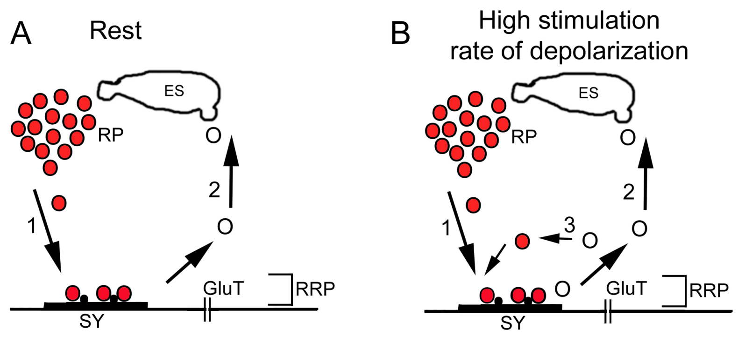

Slide 15
PRESYNAPTIC
POSTSYNAPTIC

Slide 16
PRESYNAPTIC
AP
POSTSYNAPTIC

Slide 17
Not saturated

Slide 18
Saturated
Notes:
Given two synapses. One saturated one not. Saturdated one might give a slight larger amp, given more receptors get bound, then probably one will see a broader and flatter peak. Receptor /transmitter rebound-not cleared and activation/inactivation would occur.

Slide 19
Not saturated
Off center
Notes:
Smaller EPSC with same time constant.

Slide 20
Not saturated
Saturated due to
smaller synapse
With same amount
of transmitter
Notes:
Shorter and braoder. Time constant reduced or two curves

Slide 21
3
1
2
Not saturated to
saturated based on
vesicle size and amount
released.
1
2
3

Slide 22
Not saturated
but not enough time
to recycle and refill
Time

Slide 23
RP
Not saturated
but not enough time
to recycle and refill
but can recruit from RP
Time
RP

Slide 24
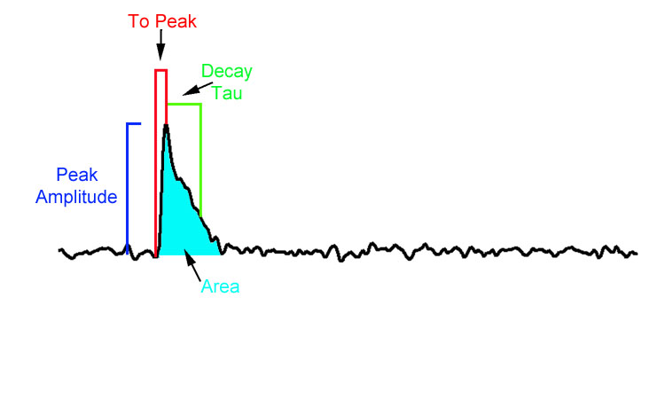
Classical Quantal Counting Methods vs. New Stochastic Measurements.
More accurately measure n and p.
Find subsets of quantal events.
Analysis programs allow measurements of all these parameters.

Slide 25
Broader Impact with NSF
To 2014 Applicants: Please note that NSF 13-1 explicitly states the requirements for addressing BOTH the Intellectual Merit (IM) and the Broader Impact (BI) review criteria for NSF proposals.
In addition to addressing IM and BI separately in the Project Summary, a separate section on BI needs to be included in the Proposal Description (GPG: "The Project Description must contain, as a separate section within the narrative, a discussion of the broader impacts of the proposed activities") .

Slide 26
The five goals articulated in the current Broader Impacts criterion
Advance discovery and understanding while promoting teaching, training and learning
b. Broaden the participation of underrepresented groups
c. Enhance the infrastructure for research and education
d. Enhance scientific and technological understanding through broad dissemination of results
e. Benefits of the proposed activity to society
2. The eight goals articulated in the America COMPETES Reauthorization Act of 2010
a. Increased economic competitiveness of the United States
b. Development of a globally competitive STEM workforce
c. Increased participation of women and underrepresented minorities in STEM
d. Increased partnerships between academia and industry
e. Improved pre ‐ K–12 STEM education and teacher development
f. Improved undergraduate STEM education
g. Increased public scientific literacy
h. Increased national security

Slide 27
NIH/NSF
Reproducibility is now of interest
Group analysis and data/models are vetted by group prior to publication
Disseminate research & share in authentic science
Science without borders

Slide 28
“Citizens Unit for Science”

Slide 29
Not saturated
but increase density
of postsynaptic receptor
density
Time
Test ?
Notes:
So how to test such possibilities? Density with exogenous application. But the other issues are more difficult. In addition one has to think of structure of the synapses. Both pre and post as the effect the recordings and which type of recording is made.

Slide 30
Focal recording
Intracellular muscle
recording
nerve
muscle
Case 1:
Case 2:
Missing quanta

Slide 32
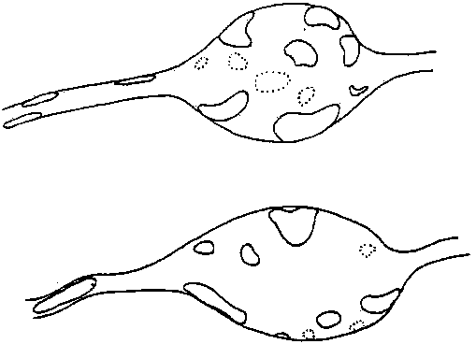

Slide 33
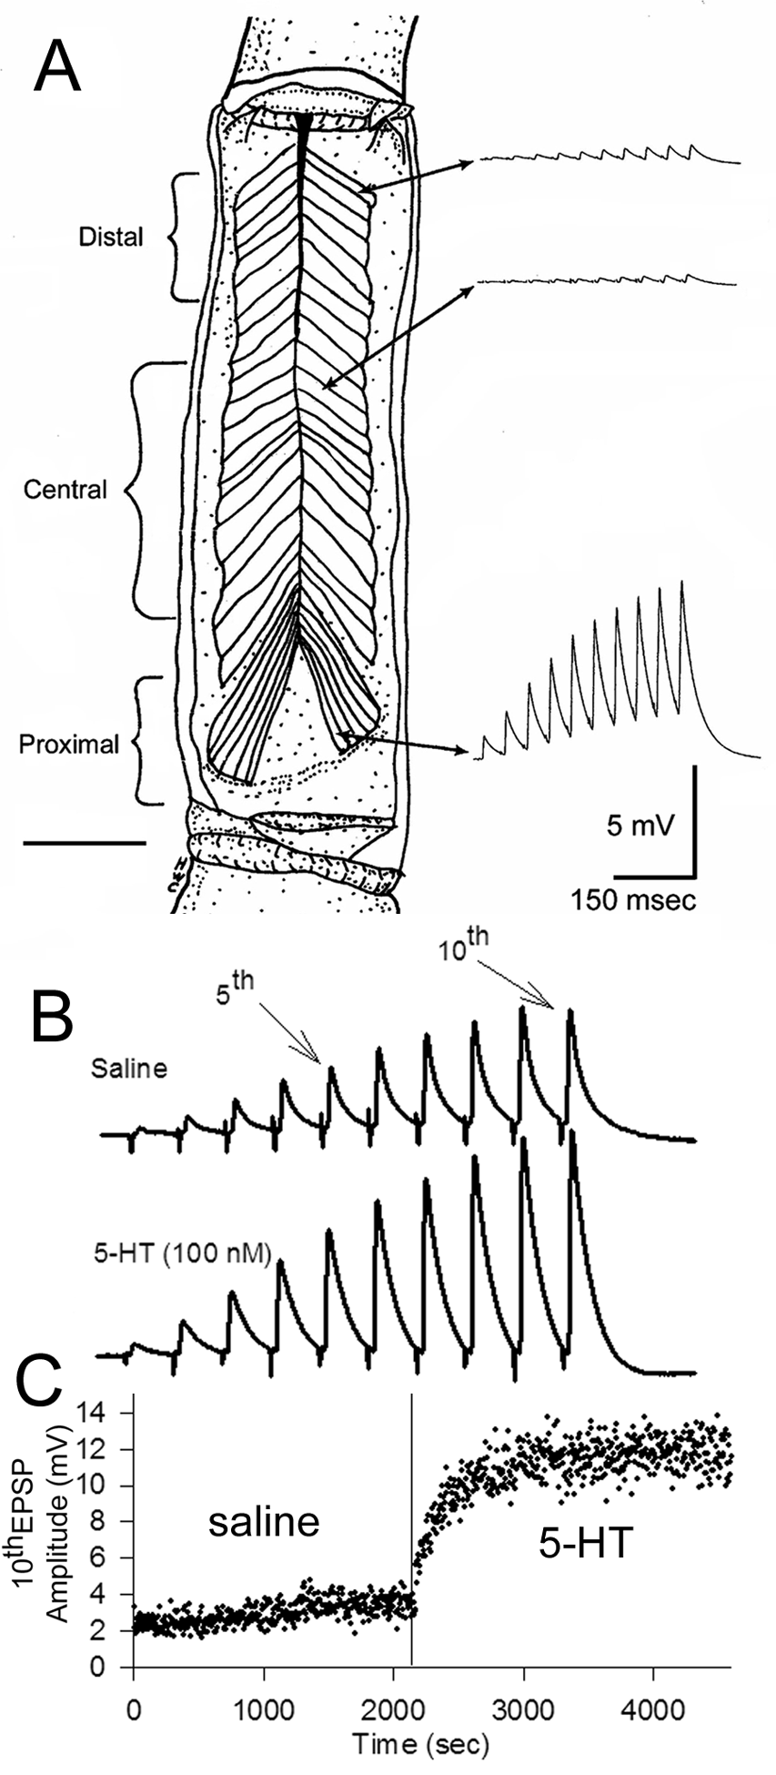

Slide 34
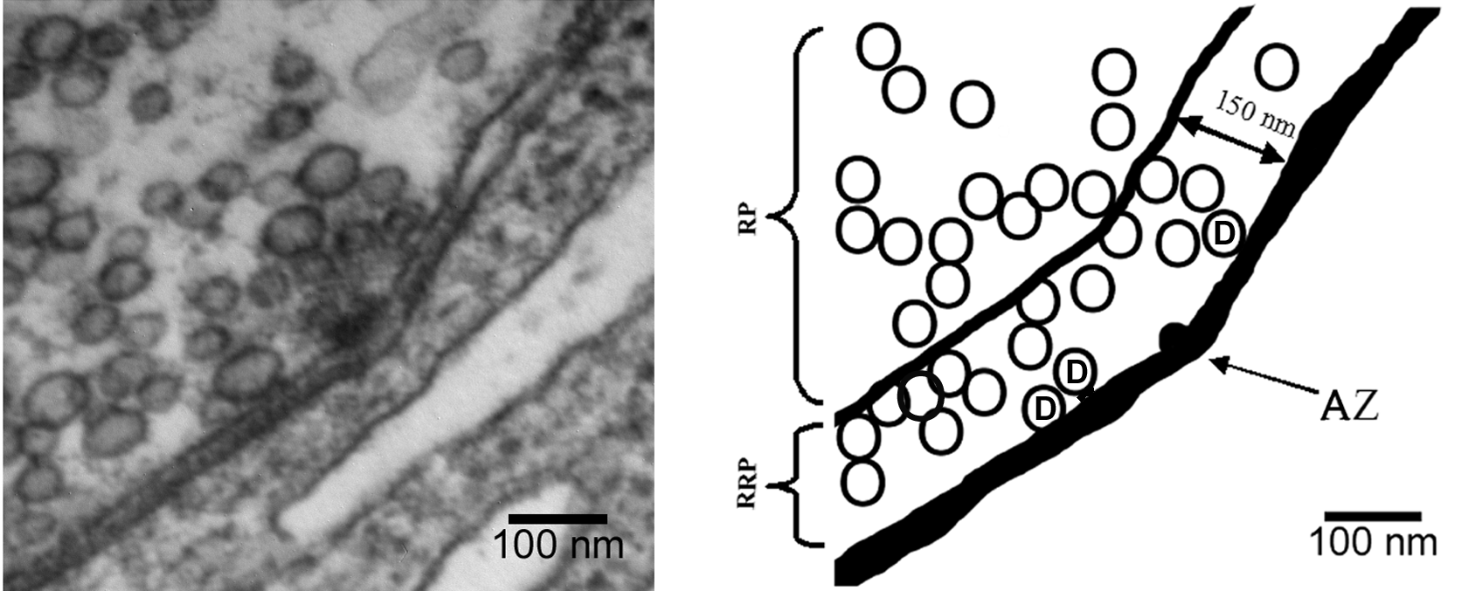

Slide 35
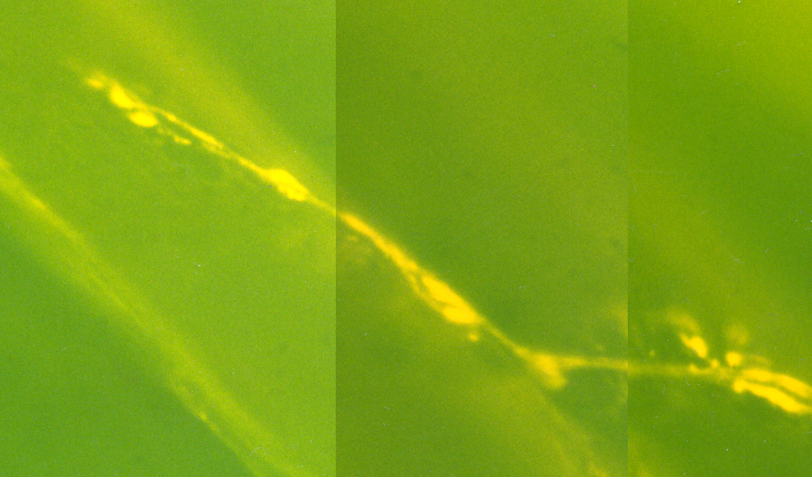
The neuromuscular junction

Slide 36
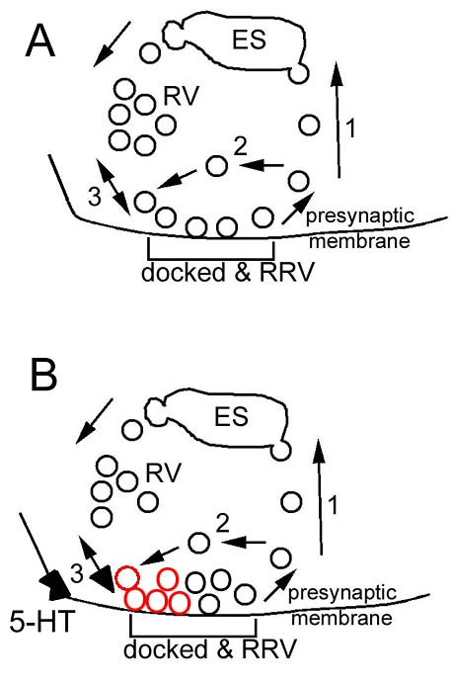
IP₃
5-HT

Slide 37
IP₃
5-HT

